Slide 1
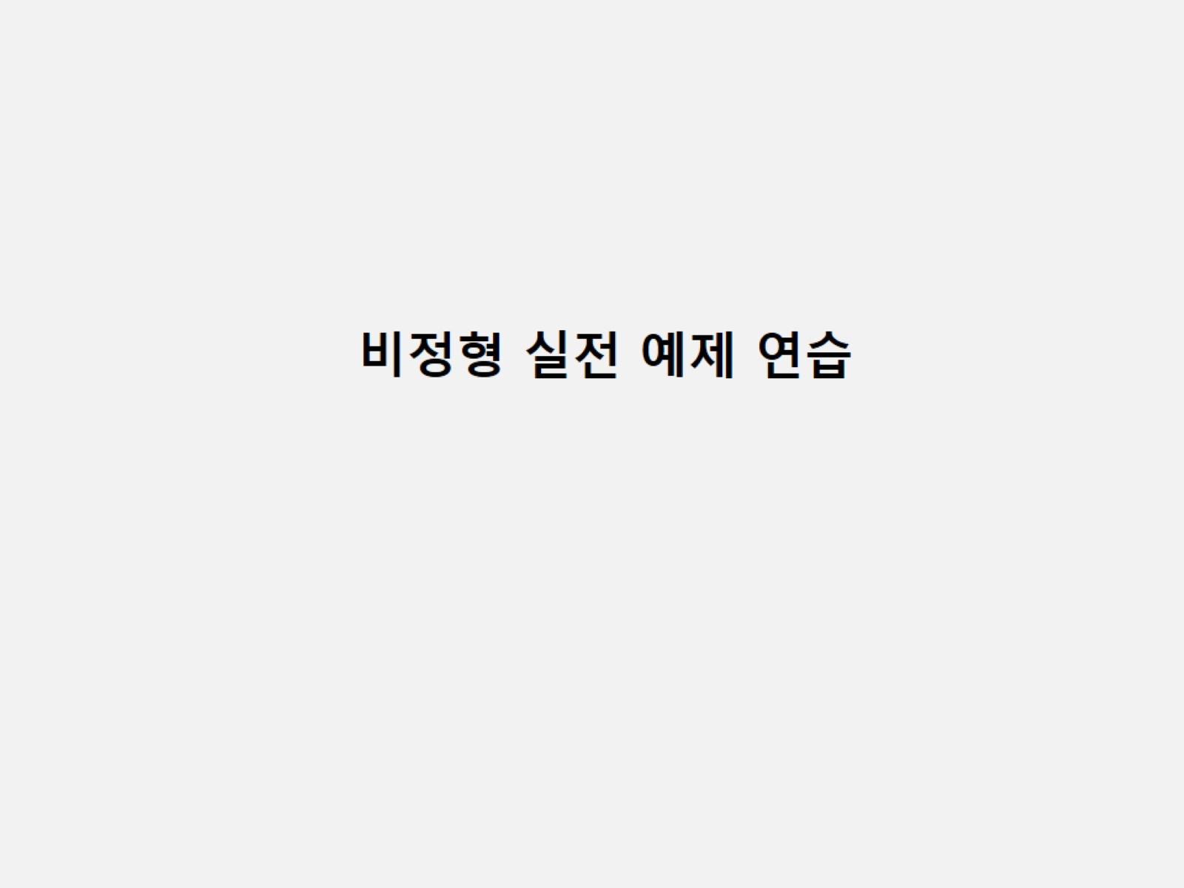

Slide 2
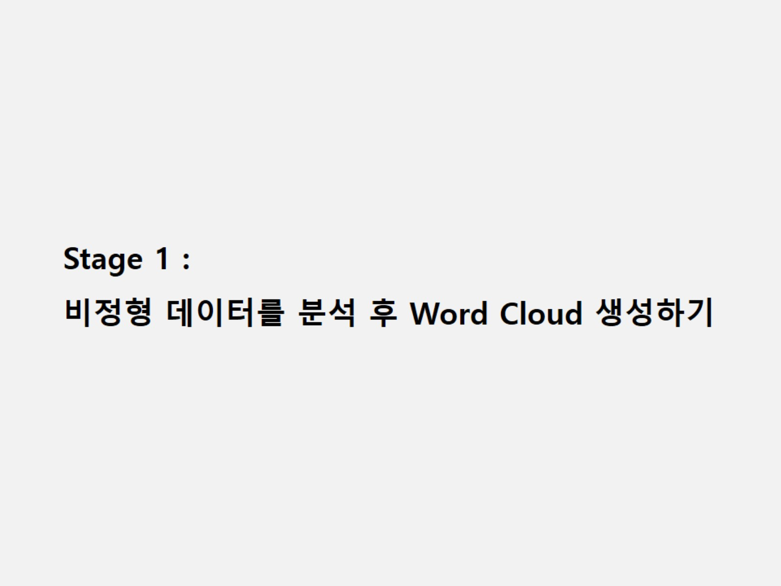

Slide 3
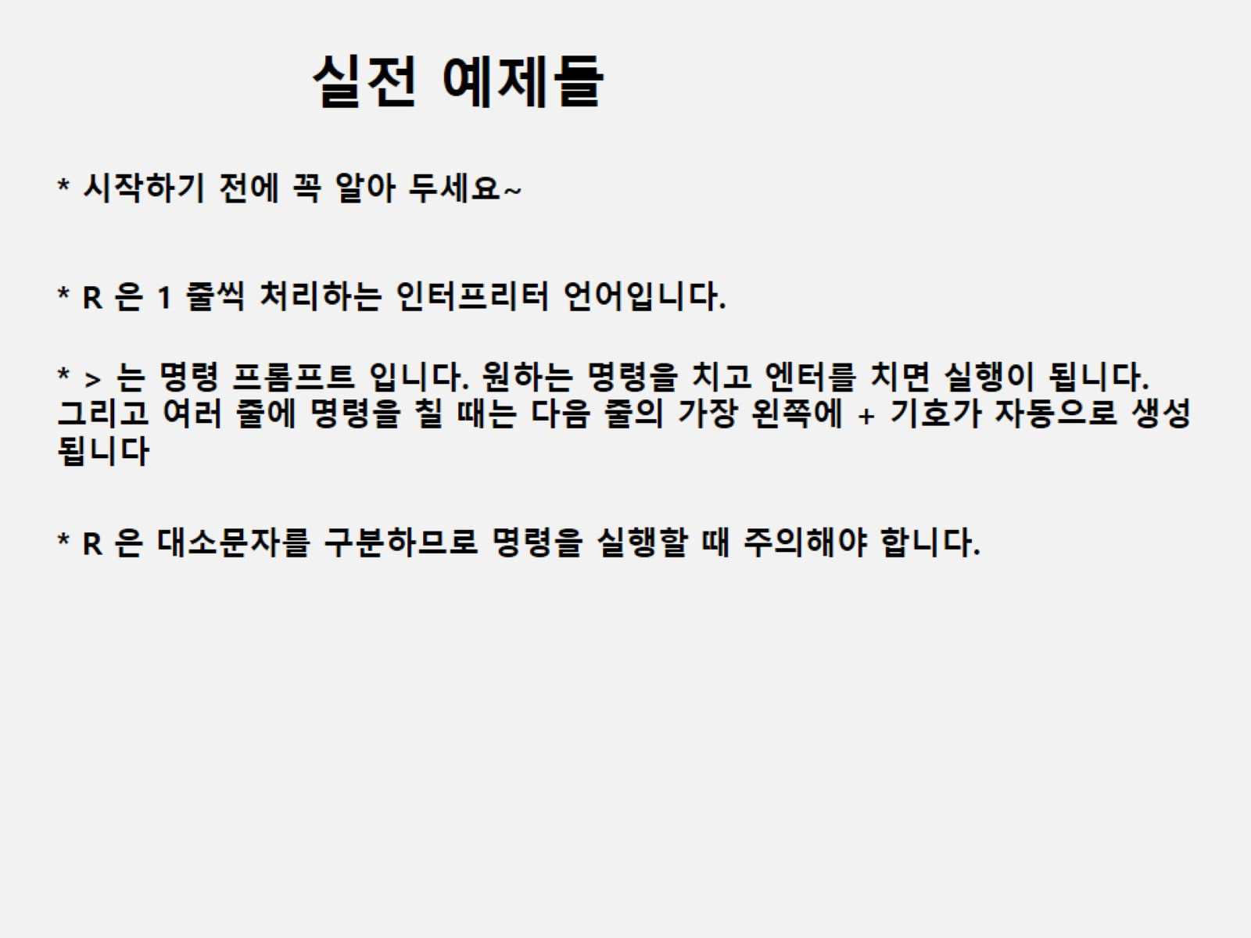

Slide 4
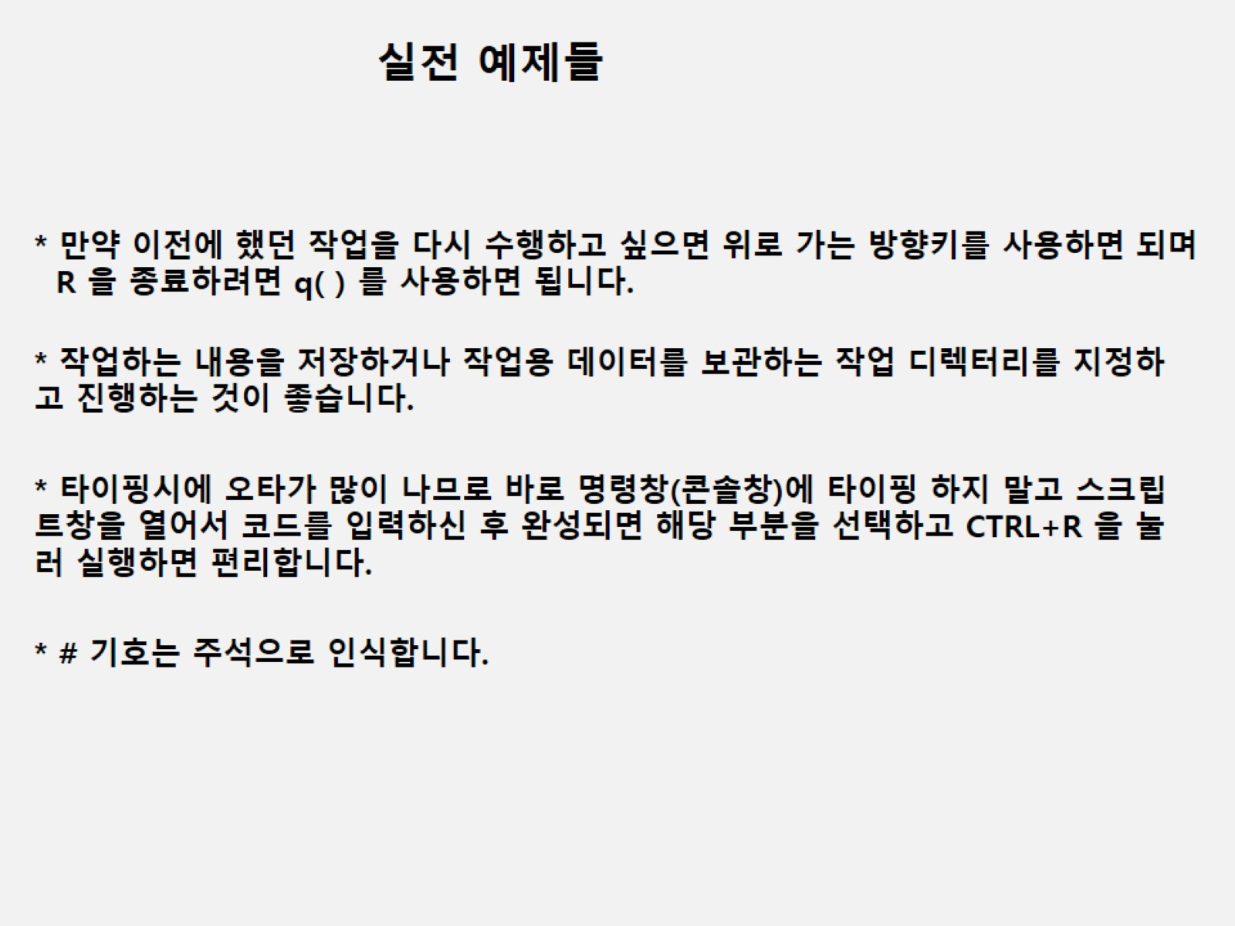

Slide 5
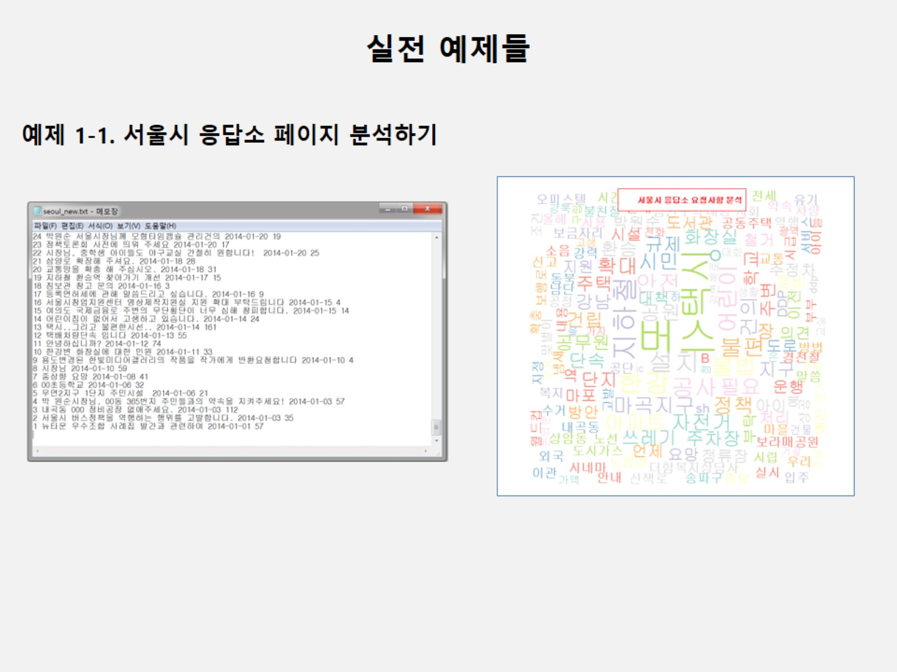

Slide 6
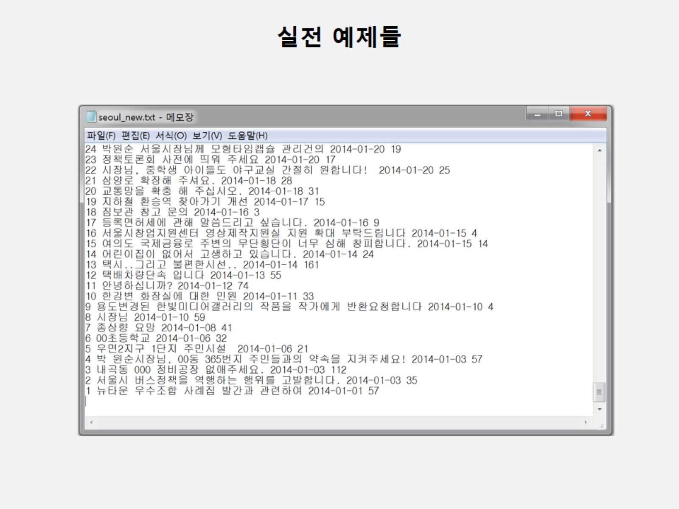

Slide 7
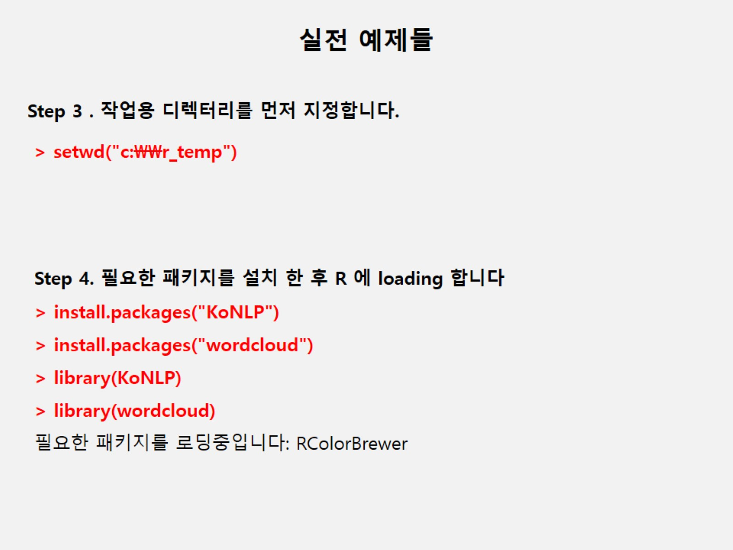

Slide 8
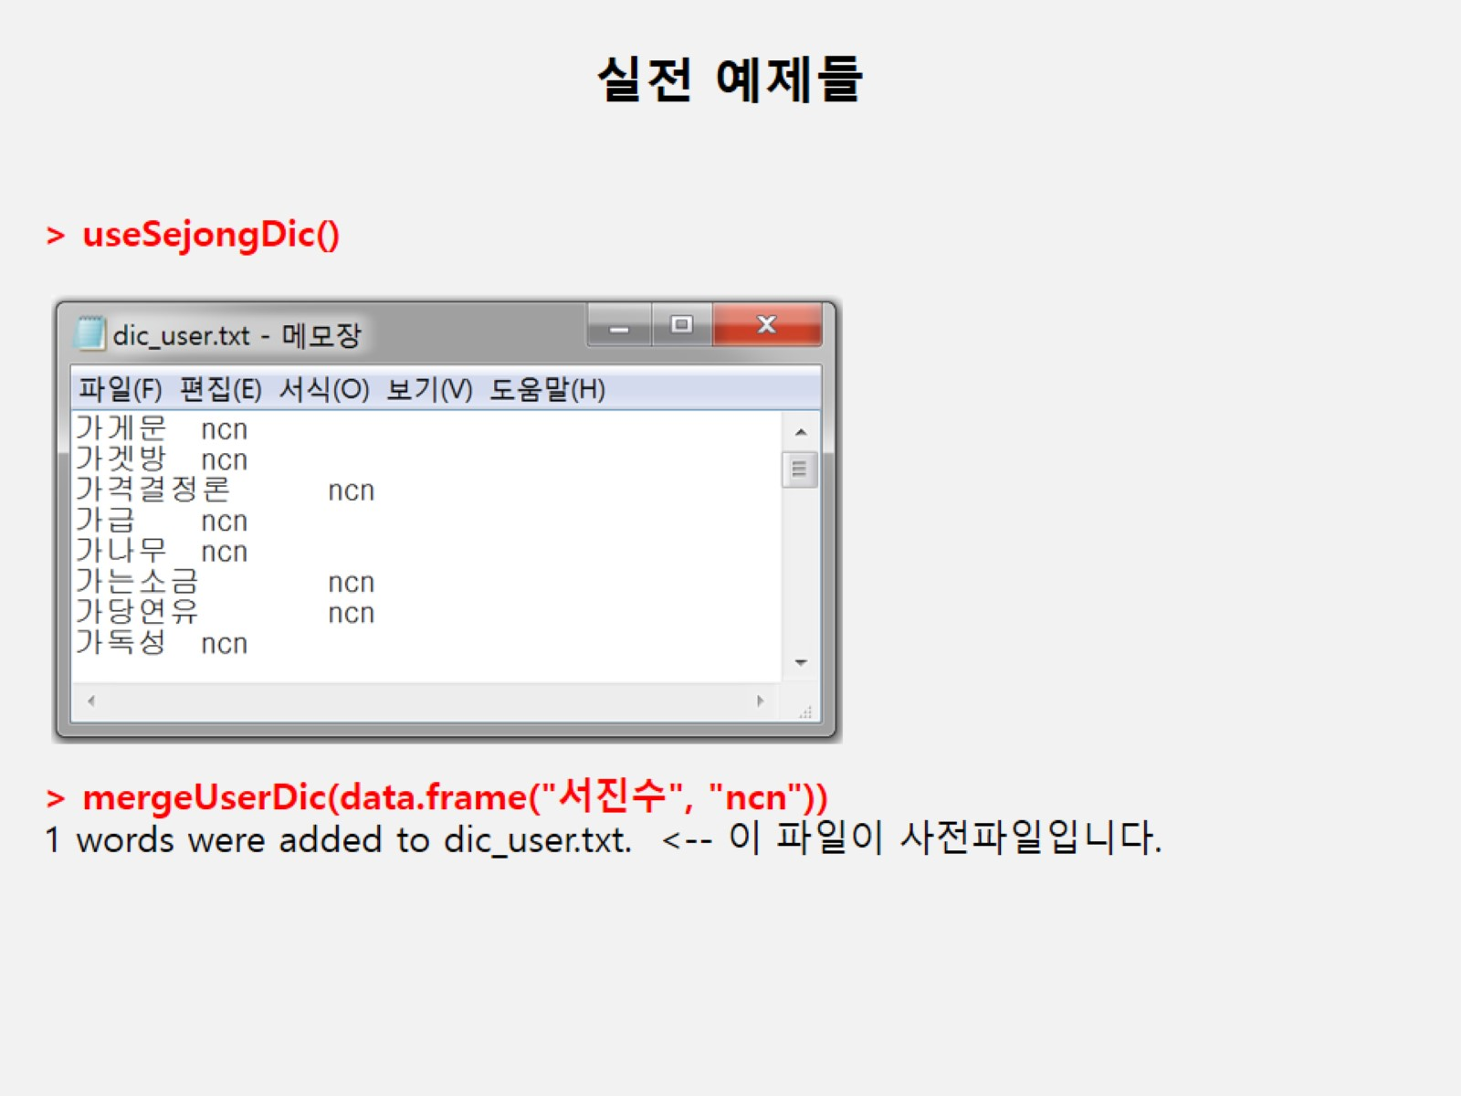

Slide 9
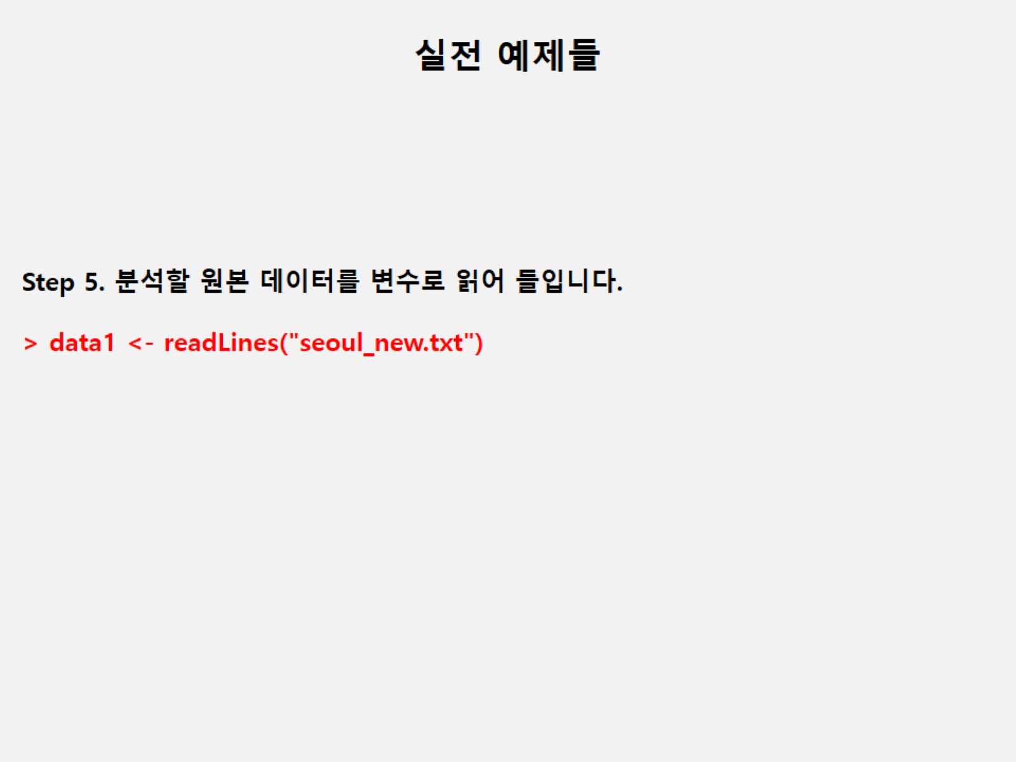

Slide 10
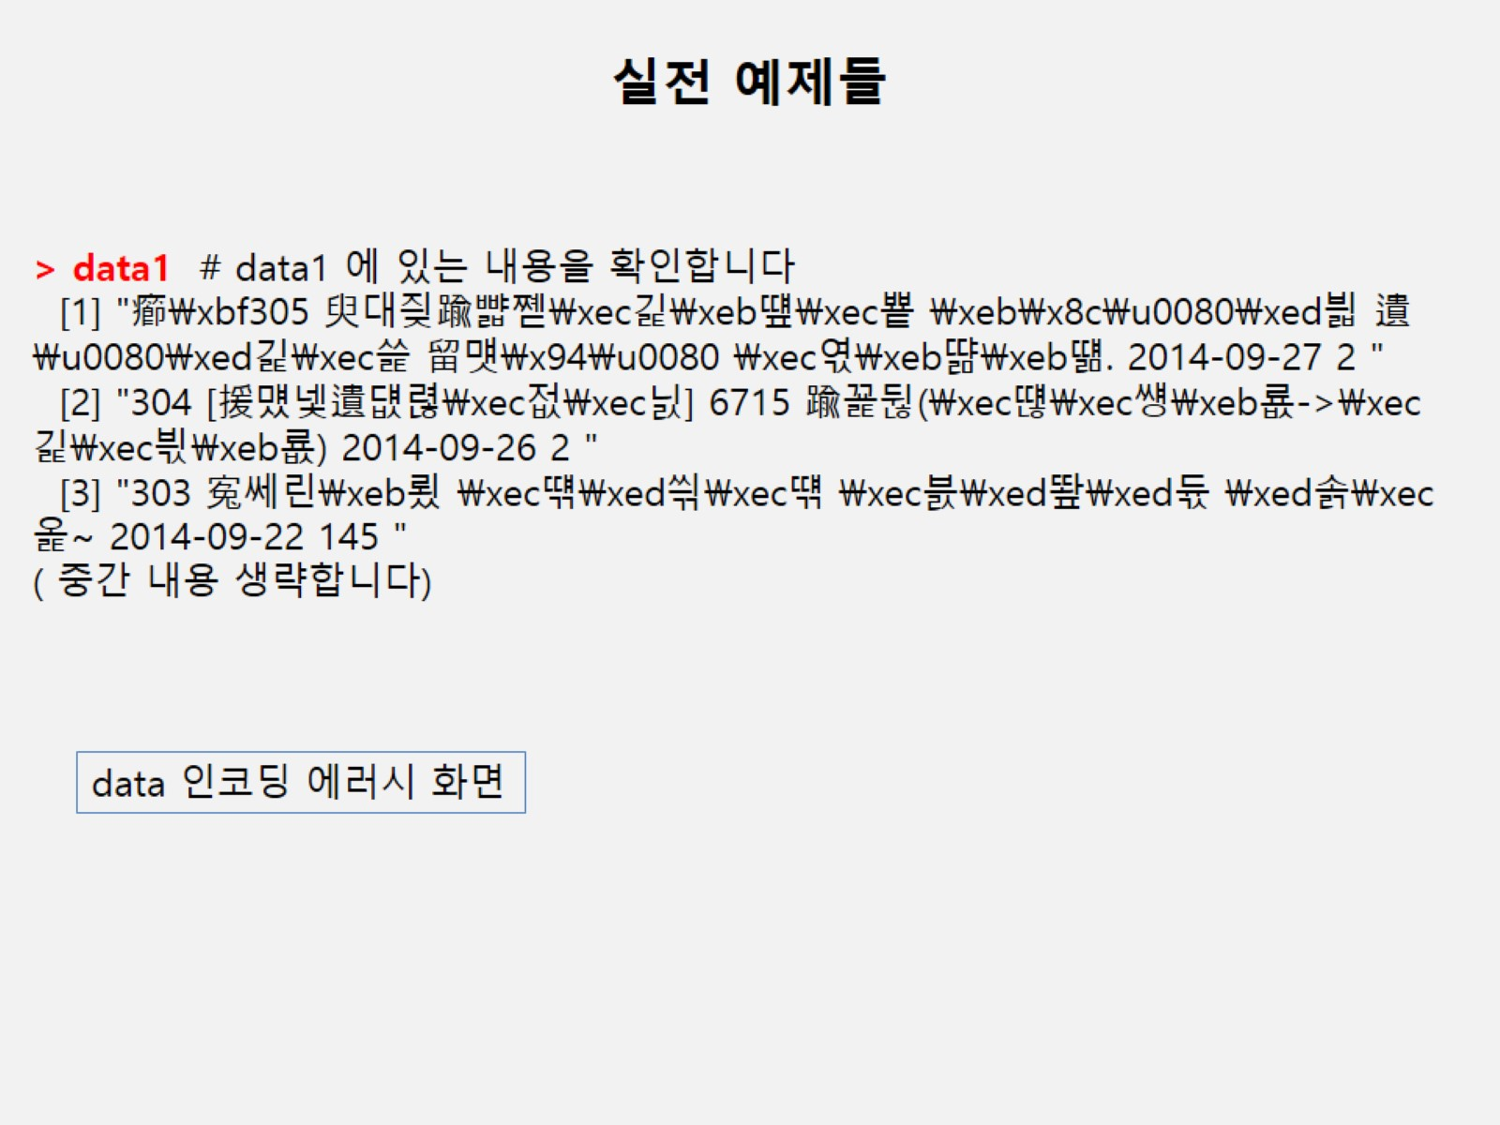

Slide 11
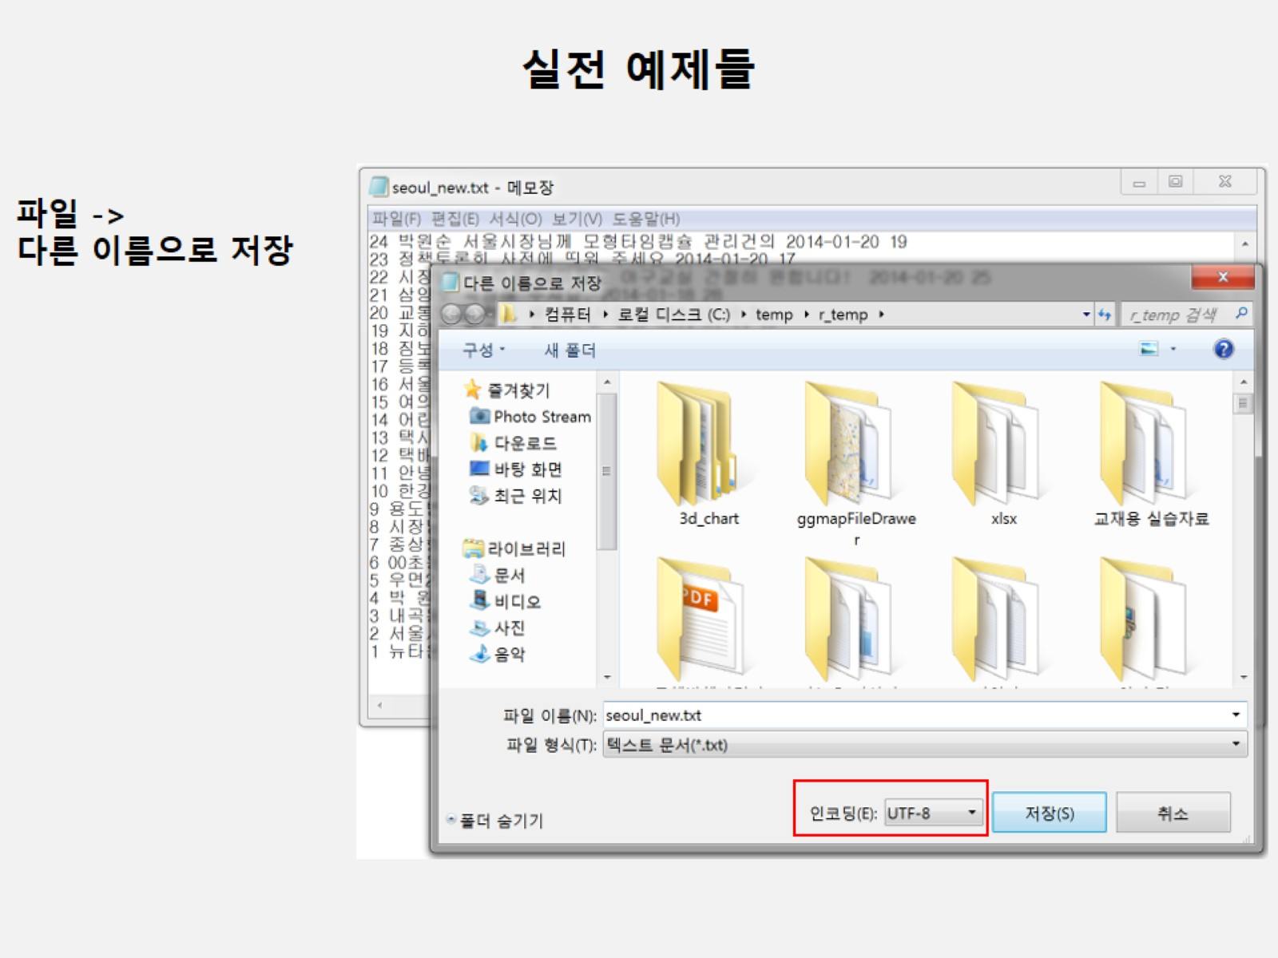

Slide 12
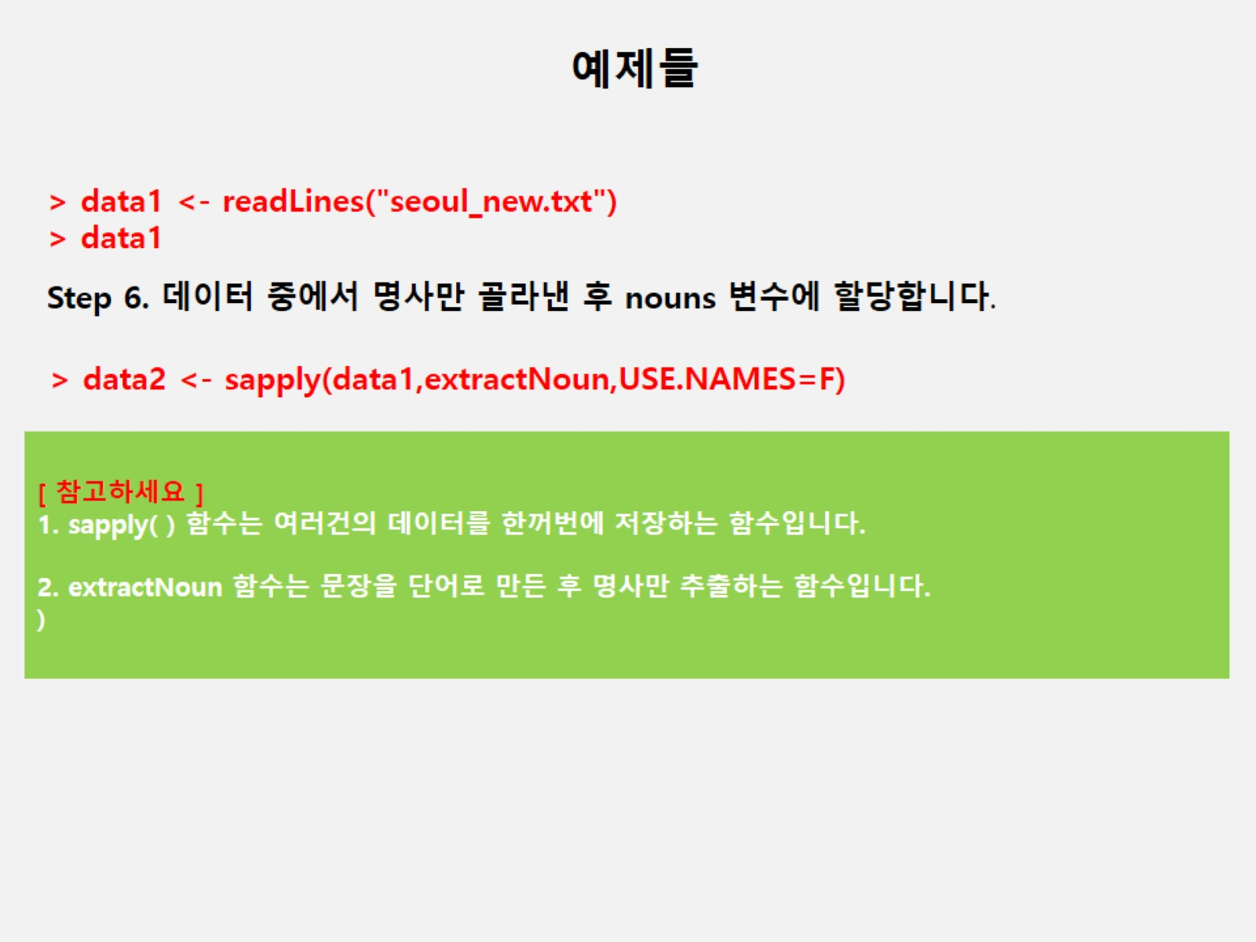

Slide 13
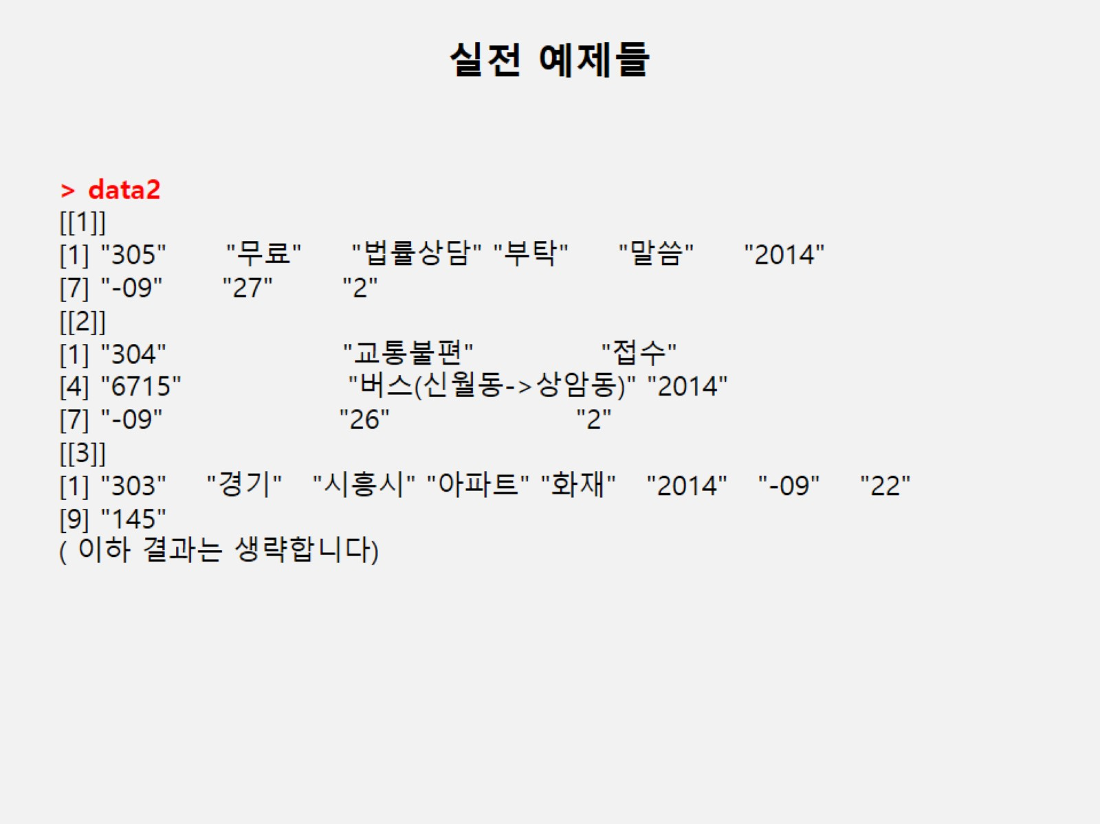

Slide 14
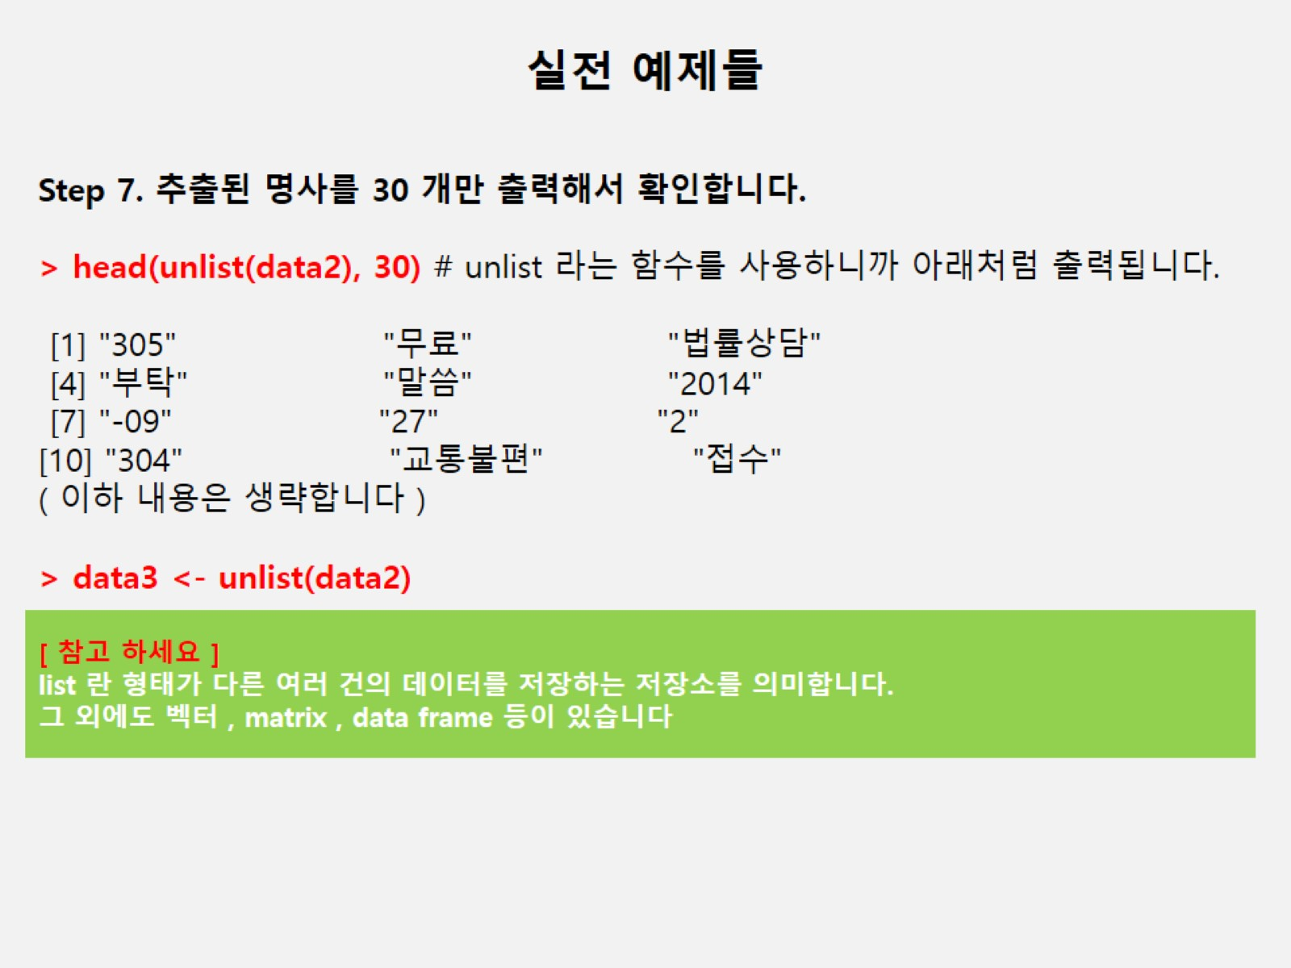

Slide 15
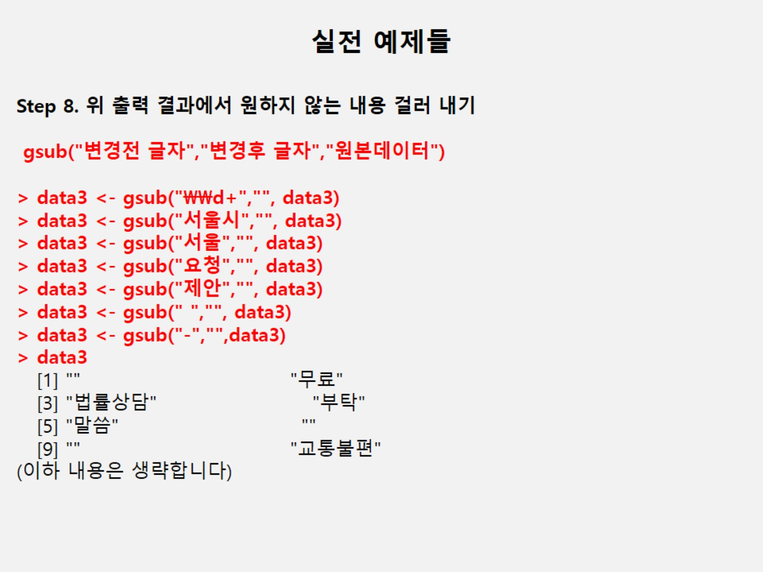

Slide 16
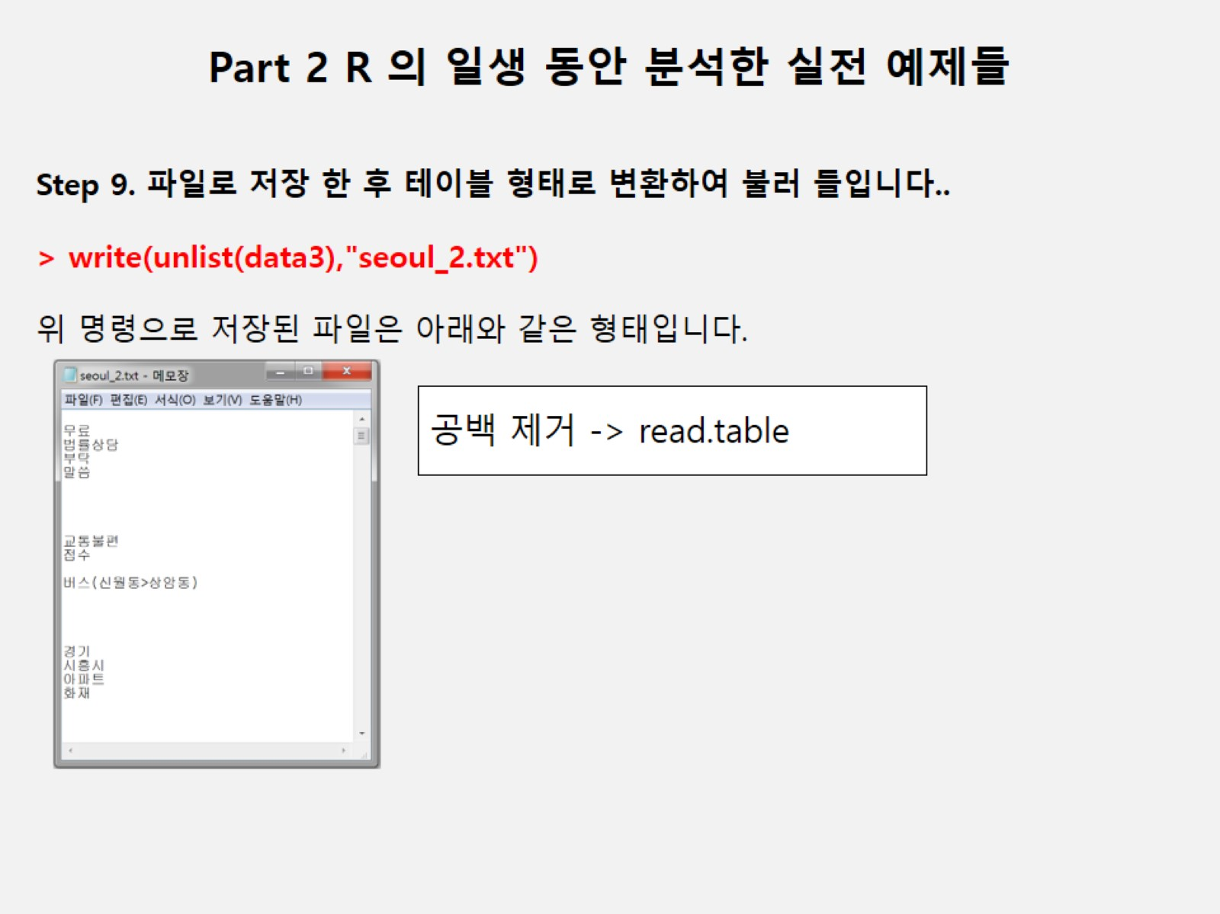

Slide 17
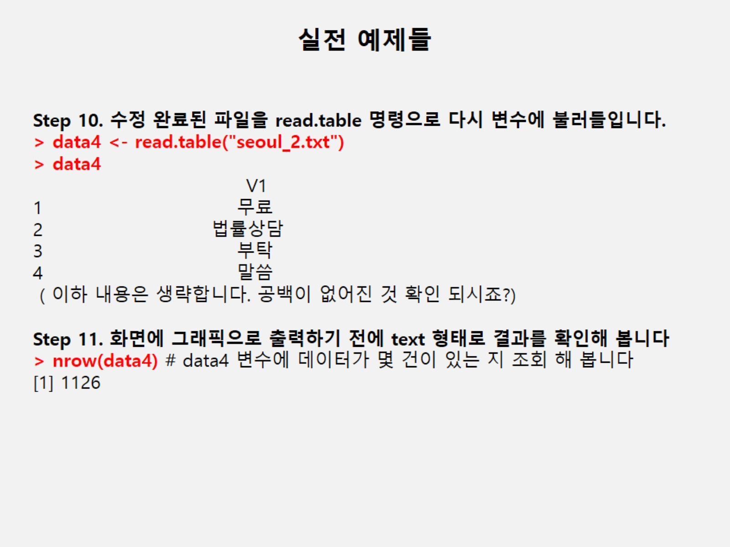

Slide 18
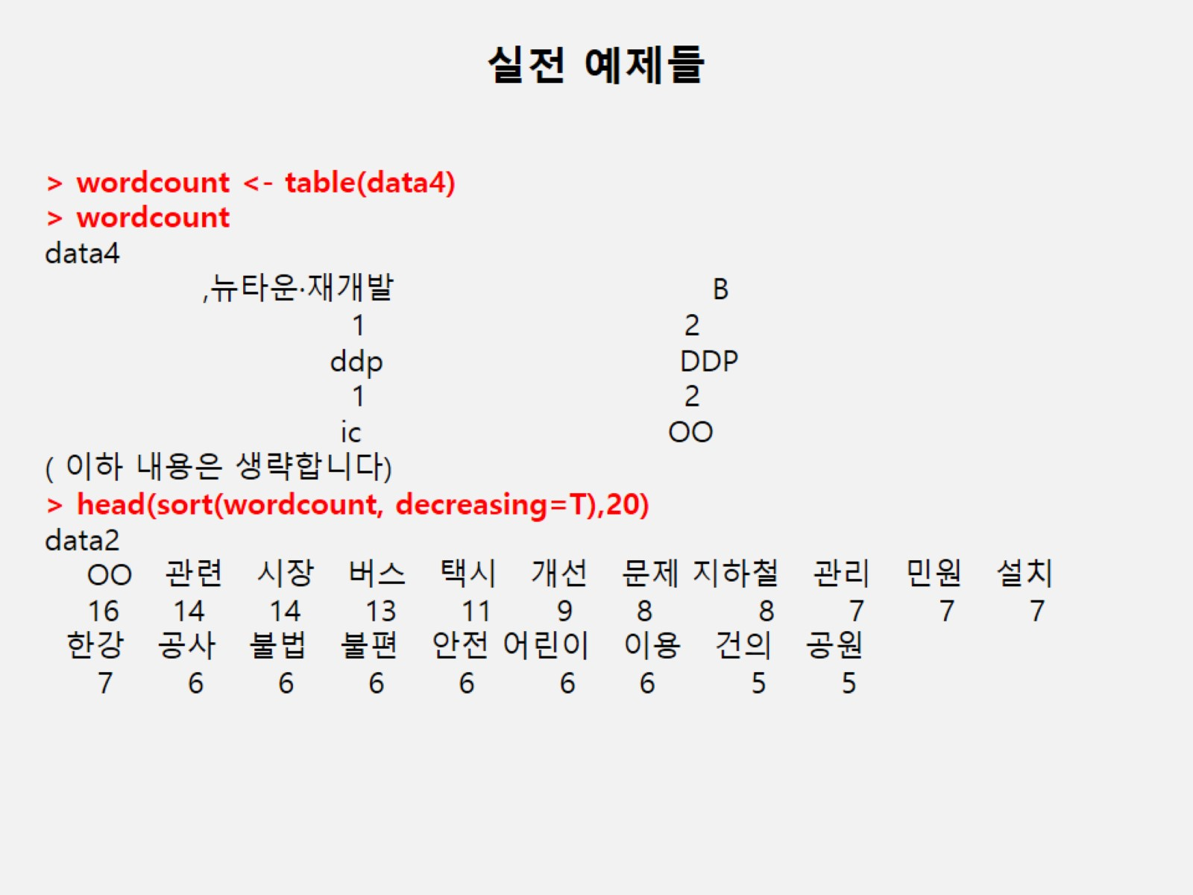

Slide 19
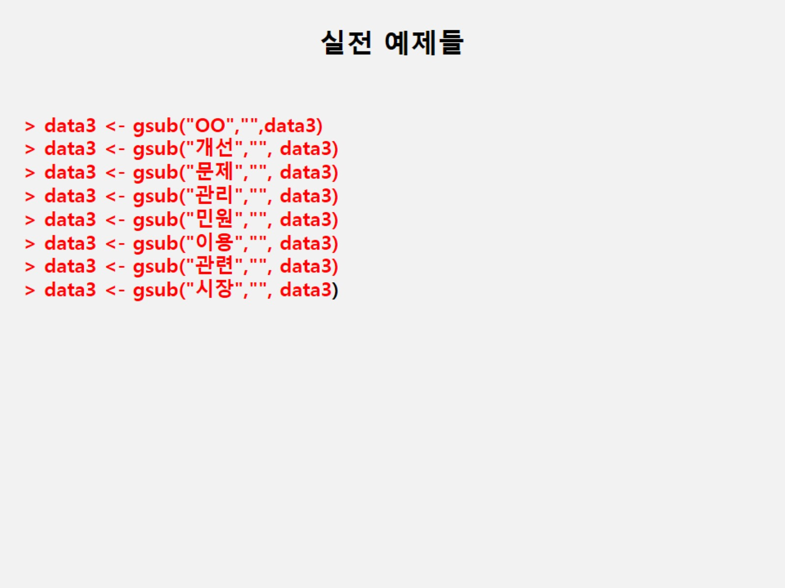

Slide 20
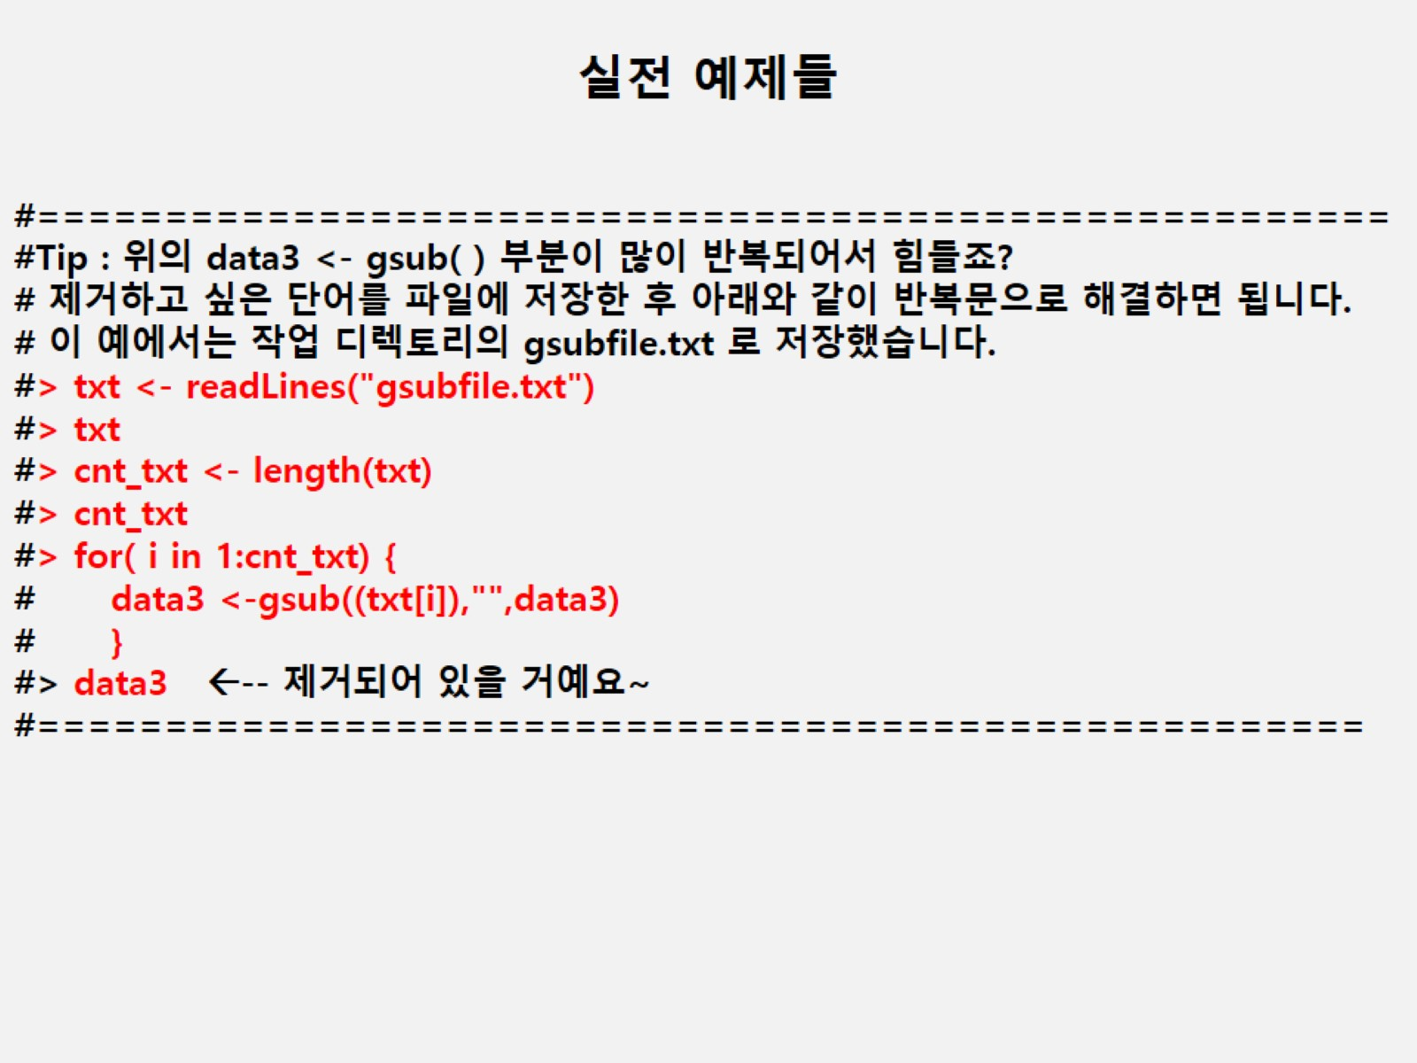

Slide 21
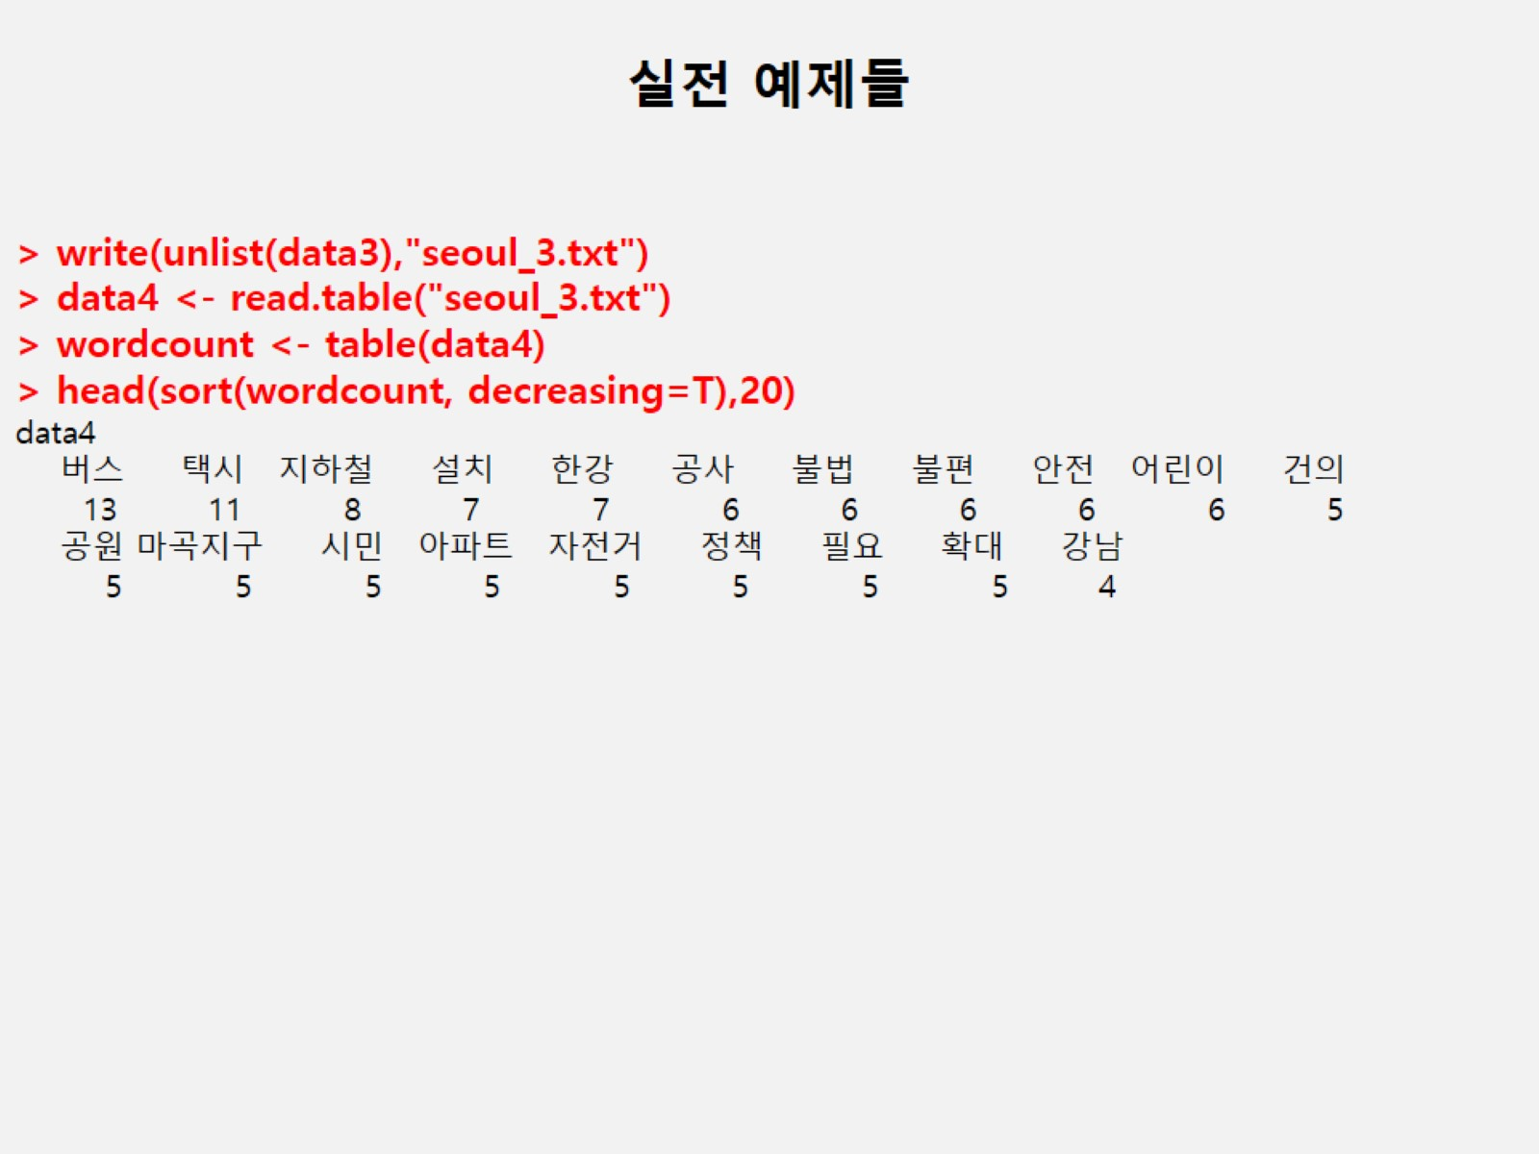

Slide 22
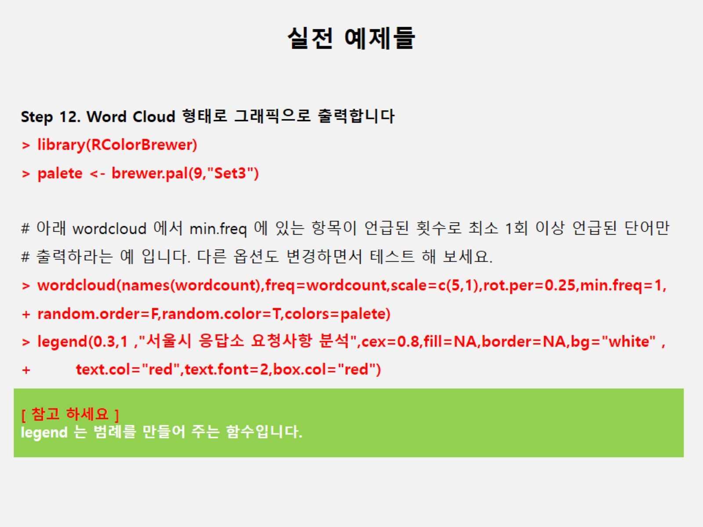

Slide 23
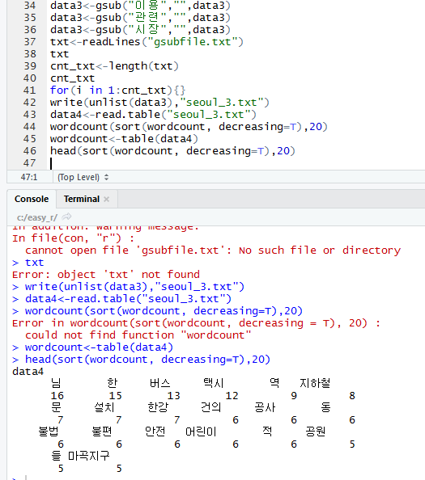

Slide 24
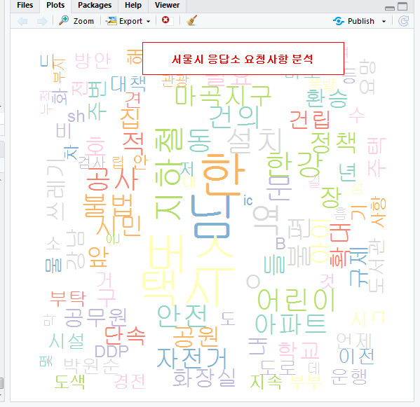
서울시 응답소 요청사항 분석
Notes:
setwd("c:\\easy_r")
install.packages("KoNLP")
install.packages("wordcloud")
library(KoNLP)
library(wordcloud)
useSejongDic()
data1<-readLines("seoul_new.txt")
data1
data2<-sapply(data1,extractNoun,USE.NAMES=F)
data2
head(unlist(data2),30)
data3<-unlist(data2)
gsub("변경전 글자","변경후 글자","원본데이터")
data3<-gsub("\\d+","",data3)
data3<-gsub("서울시","",data3)
data3<-gsub("서울","",data3)
data3<-gsub("요청","",data3)
data3<-gsub("제안","",data3)
data3<-gsub(" ","",data3)
data3<-gsub("-","",data3)
data3
write(unlist(data3),"seoul_2.txt")
data4<-read.table("seoul_2.txt")
data4
nrow(data4)
wordcount<-table(data4)
wordcount
head(sort(wordcount,decreasing =T),20)
data3<-gsub("OO","",data3)
data3<-gsub("개선","",data3)
data3<-gsub("문제","",data3)
data3<-gsub("관리","",data3)
data3<-gsub("민원","",data3)
data3<-gsub("이용","",data3)
data3<-gsub("관련","",data3)
data3<-gsub("시장","",data3)
txt<-readLines("gsubfile.txt")
txt
cnt_txt<-length(txt)
cnt_txt
for(i in 1:cnt_txt){}
write(unlist(data3),"seoul_3.txt")
data4<-read.table("seoul_3.txt")
wordcount(sort(wordcount, decreasing=T),20)
wordcount<-table(data4)
head(sort(wordcount, decreasing=T),20)
library(RColorBrewer)
palete<-brewer.pal(9,"Set3")
wordcloud(names(wordcount),freq=wordcount,scale=c(5,1),rot.per = 0.25,min.freq=1,+random.order = F,random.color=T,colors=palete)
wordcloud(names(wordcount),freq=wordcount,scale=c(5,1),rot.per =0.25,min.freq=1,random.order = F,random.color=T,colors=palete)
legend(0.3,1, "서울시 응답소 요청사항 분석",cex=0.8,fill=NA,border=NA,bg="white",text.col="red",text.font=2,box.col="red")

